Slide 1
Bank Management System

Slide 2
INTRODUCTION
Bank management system database stores information for both customers and staff
It keeps track of customer details, accounts (including type and balance) and transactions (deposits/withdrawals).
The database can even handle situations where someone deposits money for another customer.
For loan management, it stores details like borrower information, loan amounts and interest rates.
By linking tables together, the dataset ensures data accuracy and allows for easy retrieval of information, such as finding all transactions for a specific account.

Slide 3
Use of DBMS in Bank Management System
1. Data Security and Integrity: A DBMS offers robust security features to
protect sensitive customer information like account details, financial
transactions, and passwords.
2. Data Backup and Recovery: A DBMS provides mechanisms for data
backup and recovery.
3. Transaction Processing: A DBMS ensures smooth handling of financial transactions, including deposits, withdrawals, and loan payments.
4. Efficient Data Management: Banks deal with massive amounts
of data daily. A DBMS allows for efficient storage, organization, and retrieval of this data.

Slide 4
Database SCHEMA
The database structure for a Bank Management system includes:
Tables: These represent different entities in the Bank system which are Bankstaff, Customer, Account, Transaction, Depositor, Fixeddeposit, Loan, Borrower.
Primary Keys: Unique identifiers for each record in a table, ensuring that each entry is distinct.
In this Database Primary Key of each table are as follows-
Table | Primary Key
BankStaff | StaffID
Customer | AccountID
Account | AccountID
Transaction | TransactionID
Table | Primary Key
Depositor | email
Fixeddeposit | FDID
Loan | loannumber
Borrower | loannumber

Slide 5
Foreign Keys: Keys that reference primary keys in other tables, establishing relationships between entities.
In this Database Foreign Key apply on following attributes-
Table | Primary Key
BankStaff | None
Customer | None
Account | AccountID (Customer)
Transaction | AccountID (Customer)
Depositer | AccountID (Customer)
FixedDeposit | AccountID (Customer)
Loan | None
Borrower | Loannumber (Loan)

Slide 6
ER Diagram

Slide 7
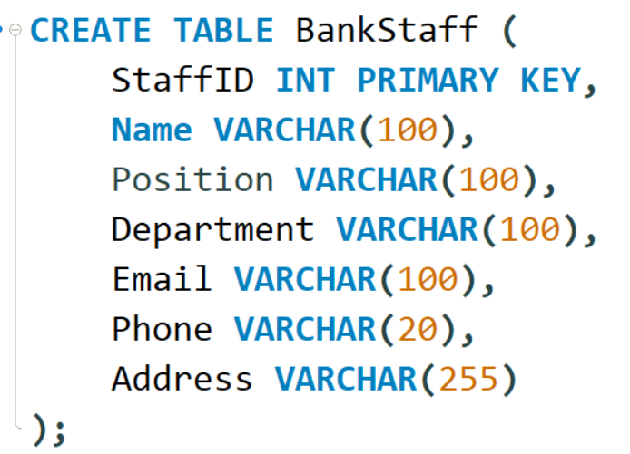
BankStaff Information
BankStaff table serves the information of the each employee of the Bank.
StaffID is the primary key.
The table stores essential details such as
Staff member’s name.
Their designated position within the bank.
The department to which they belong.
Their contact information including email and phone number.
As well as their residential or office address.
BankStaff
StaffID
Name
Position
Department
Email
Phone
Address

Slide 8
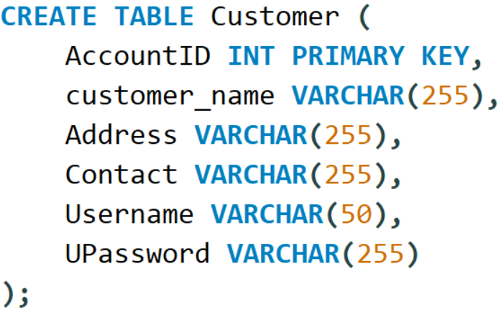
Customer Information
Customer table which indicates customer information
CustomerId is the primary key.
The table stores essential details such as
Customer name.
Their account number as accounted.
Username and password for account
Their contact information including email and phone number.
As well as their residential or office address.
Customer
AccountID
Customer_name
Username
CustomerId
Upassword
Contact
Address

Slide 9
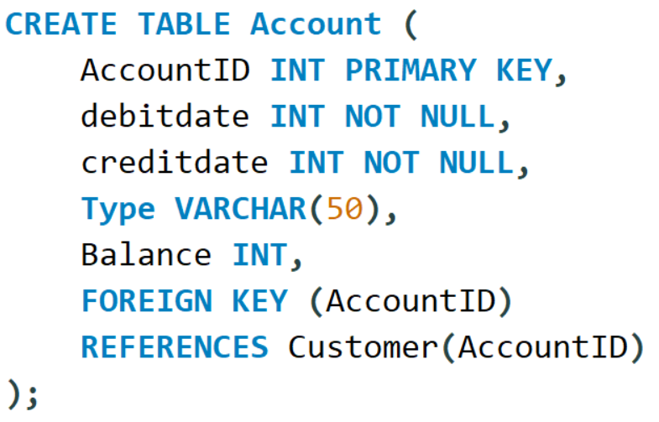
Account Information
It used to store the all the information related to the customer account
AccountID is the primary key in the table.
Table Stores the following details
AccountID
Debitdate
Balance
Creditdate
type
Account
AccountID
Balance
Debitdate
Creditdate
Balance
Type

Slide 10
BankStaff
StaffID
Name
Position
Department
Email
Phone
Address
Account
AccountID
Balance
Debitdate
Creditdate
Balance
Type
Customer
AccountID
Customer_name
Username
Upassword
Contact
Address
Borrower
AccountID
LoanNumber
Customer_Name
Address
FixedDepositor
FDID
AccountID
Name
Amount
InterestRate
StartDate
DurationMonths
Depositor
AccountID
Name
Address
Phone
Email
Transaction
AccountID
TransactionID
Type
Amount
FixedDepositor
LoanNumber
LoanHolder
BranchName
Amount
InterestRate
StartDate
DurationMonths

